Slide 1

Donation
Charity Management
Software Engineering – CCAS 4.3, University Project

Slide 2
Motivation
Addressing Key Issues in Donation Management
Lack of Transparency
Manual Tracking Errors
Transparency is essential for building trust between donors and charities. When donors lack clear visibility into how their contributions are collected, managed, and utilized, confidence in charitable campaigns decreases. This uncertainty can significantly reduce donor participation and long-term engagement, making transparency a critical factor in successful fundraising.
Manual tracking can lead to errors in financial reporting and donor communications. An automated system minimizes these risks, ensuring accurate records and fostering stronger relationships with supporters.

Slide 3



Key Stakeholders in Our System
Individual Donors
Essential contributors seeking impactful charitable opportunities.
Charities/Non-Profits
Organizations dedicated to making a positive difference.
Campaign Managers
Professionals driving campaigns and ensuring success.

Slide 4
System Overview
A Centralized Donation Platform
Centralized Platform
Secure Processing
Campaign Management
Our system acts as a hub connecting donors and charities, facilitating easy interactions and ensuring that contributions reach the intended causes efficiently and transparently.
We prioritize secure donation processing, utilizing advanced encryption and compliance with industry standards to safeguard sensitive donor information and ensure safe transactions throughout the platform.
The platform includes comprehensive campaign management tools that allow charities to create, manage, and monitor fundraising campaigns, enhancing visibility and engagement with potential donors.

Slide 5
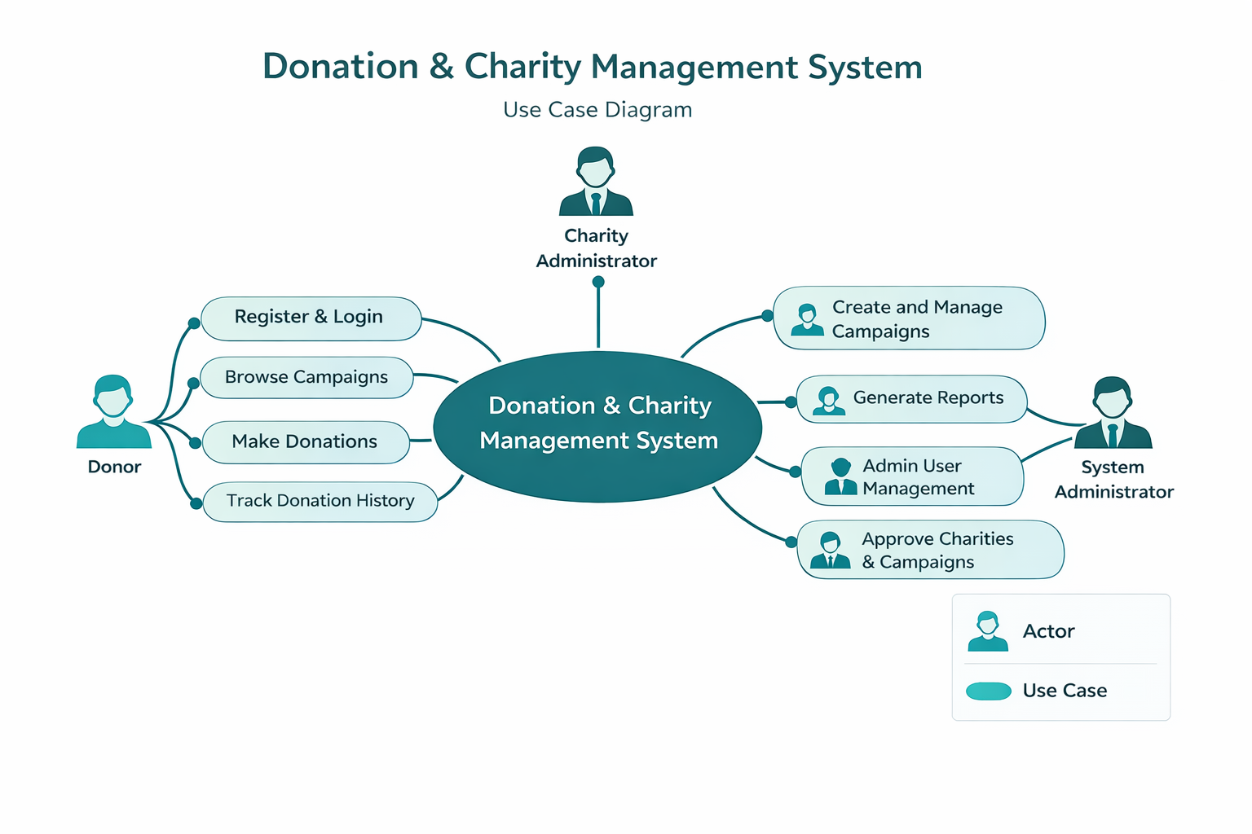
Use Case Diagram
System Interactions
This diagram illustrates the interactions between the Donor, Charity Administrator, and System Administrator, highlighting core functionalities and user engagement within the Donation & Charity Management System.

Slide 6
Functional Requirements
Categorizing Essential System Features
Must Have
Should Have
Could Have
Secure donation processing to ensure all financial transactions are safe
Strong user authentication to protect donor and charity accounts
Easy account management for donors
Ability for donors to track and manage their contributions securely
Campaign management tools to create and monitor fundraising campaigns
Transparency dashboards to track donation progress and performance
Real-time insights into how funds are collected and utilized
Impact reports that allow donors to see the results of their contributions
Recurring donation options to allow continuous support for causes
Social media integration to share campaigns and donations
Increased donor engagement through easier and more flexible contribution methods
Enhanced visibility and support for charitable campaigns

Slide 7
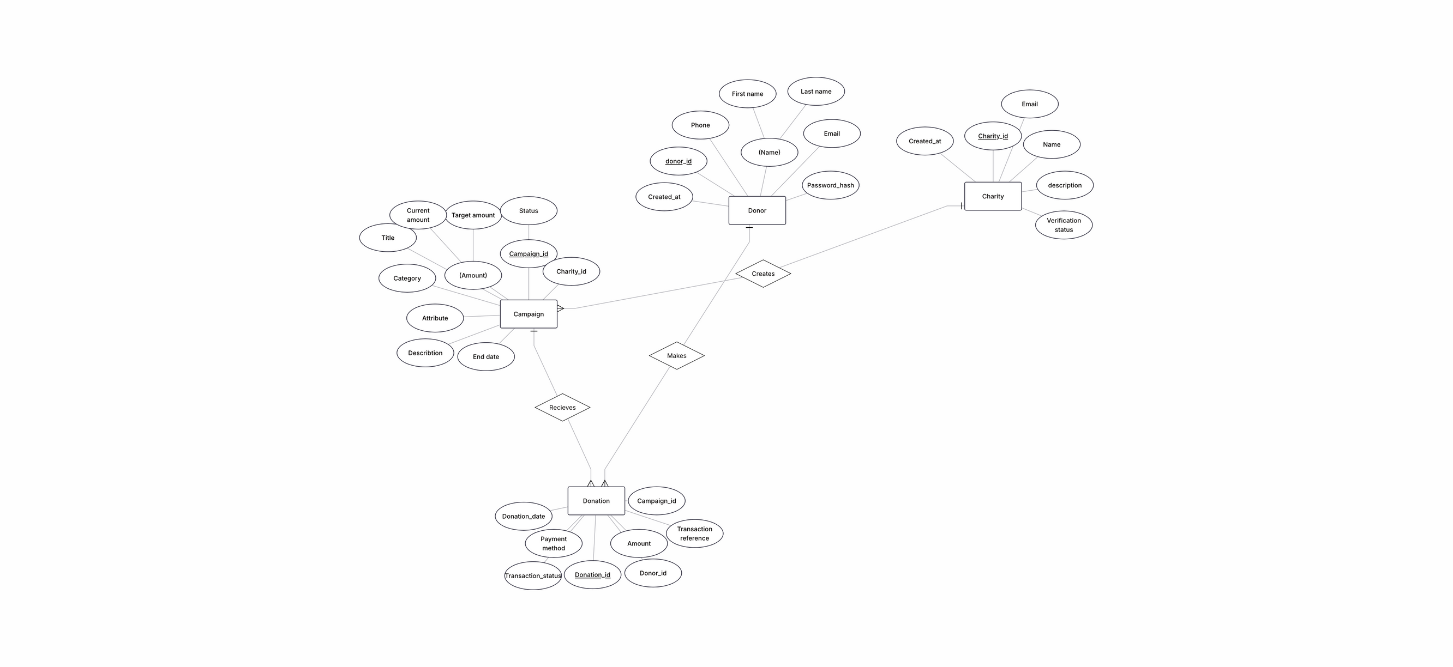
Database Design
Entity-Relationship Diagram
Shows the main tables in the system
Explains how donors, charities, campaigns, and donations are connected
Allows tracking of one-time and recurring donations
Helps keep data organized and accurate
Supports reporting and transparency in the system

Slide 8
Database Schema
Key Tables and Relationships
Donor Table
Charity Table
Campaign Table
Stores information about donors in the system
Includes donor ID, name, email, and contact details
Helps identify each donor uniquely
Supports secure communication and donation tracking
Stores information about registered charities
Includes charity ID, name, mission statement, and address
Helps identify and manage each charity
Supports organizing and monitoring charity activities within the system
Stores information about fundraising campaigns
Includes campaign ID, title, description, and start/end dates
Links each campaign to its related charity
Helps track campaign progress and performance

Slide 9
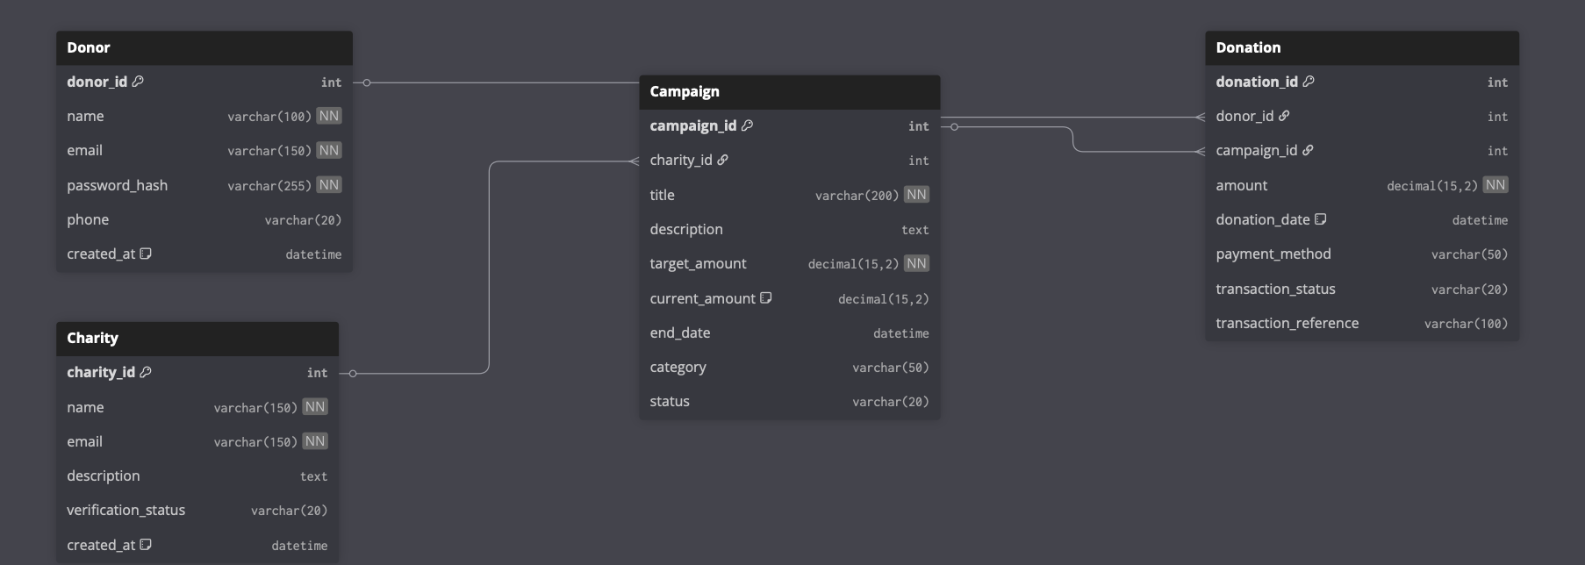
Database design
Demonstrating Database Functionality and Interactions

Slide 10
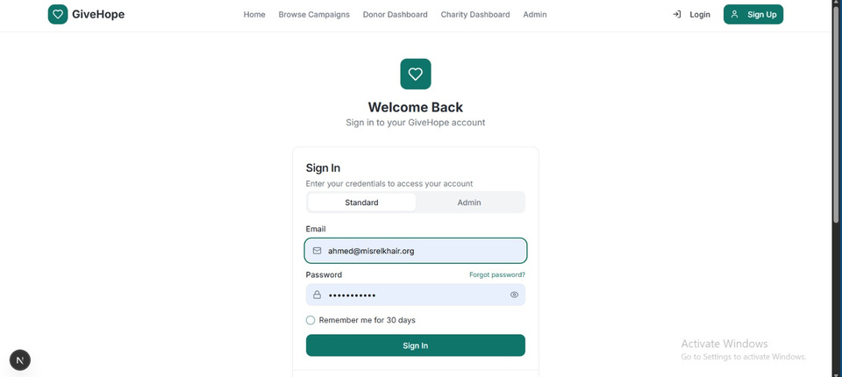
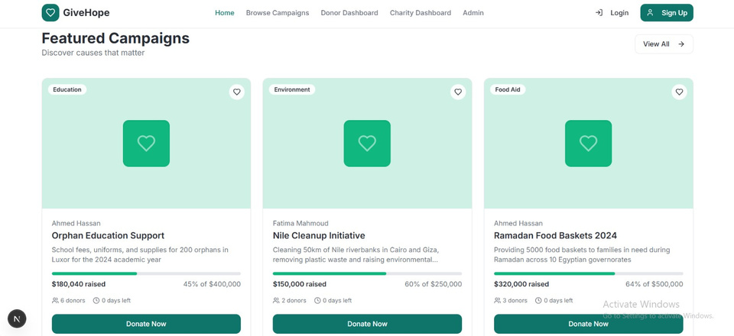
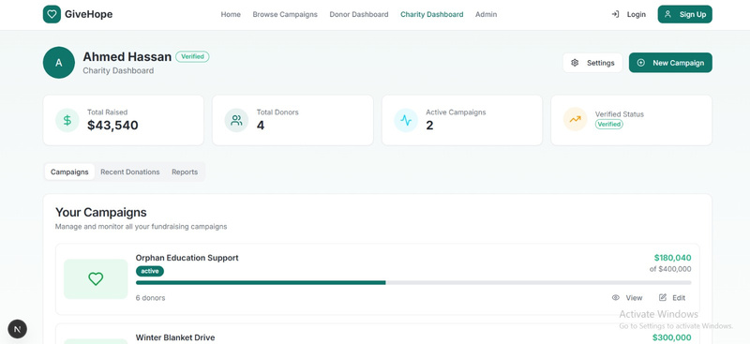
GUI and System Features Overview
User-Friendly
The interface is designed for seamless navigation.
Donation Forms
Simple forms to facilitate quick and easy donations.
Campaign Dashboards
Visual metrics for tracking donation campaign performance.

Slide 11
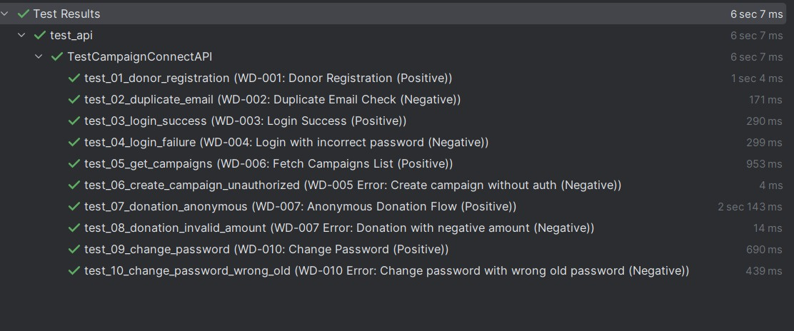
Testing & Validation
Ensuring Quality and Reliability

Slide 12
Project Milestones
Requirements
Development
GUI Design
Testing
Completed initial requirements specification to define project scope and deliverables.
Developed ERD, schema, and SQL queries to establish core database structure.
Created the user-friendly GUI design to enhance user experience and accessibility.
Conducted comprehensive testing to ensure functionality and performance of the system.

Slide 13

Thank You
We appreciate your interest in our project and support in donations.

